Slide 1
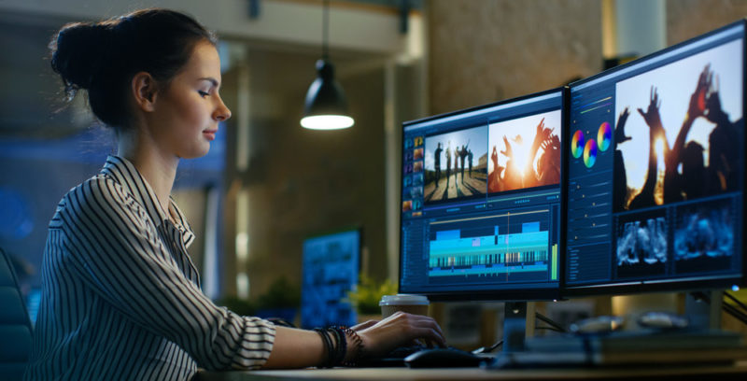
History of computing
by
Francisco David Martín Reguero

Slide 3
